Slide 1
Final Project Machida Hiroaki

Slide 2
Contents
Demo
Class Diagram
Sequence Diagram
Features
Spring MVC
BotUI
JFreeChart
Performance Test

Slide 3
Demo

Slide 4

Implemented as web service based on Spring MVC(Model, View, Controller) Framework
Class Diagram
Spring MVC
Framework
Request
Controller
BotUI
Javascript
HWUtil
Database

Slide 5
Spring delegates request to controller, controller calls HWUtil methods
Sequence Diagram
BotUI
Javascript
:Spring MVC
Framework
:Request
Controller
:HWUtil
:Database
query
identify method
call helper
access
return
return
return
return

Slide 6
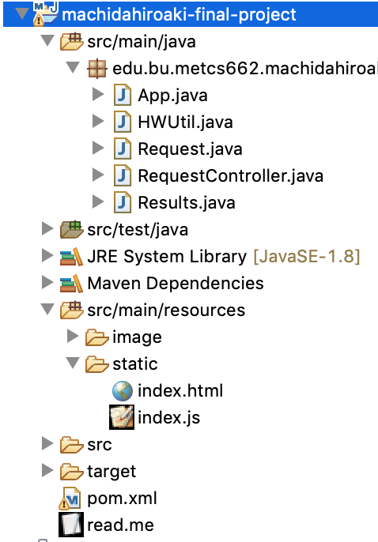
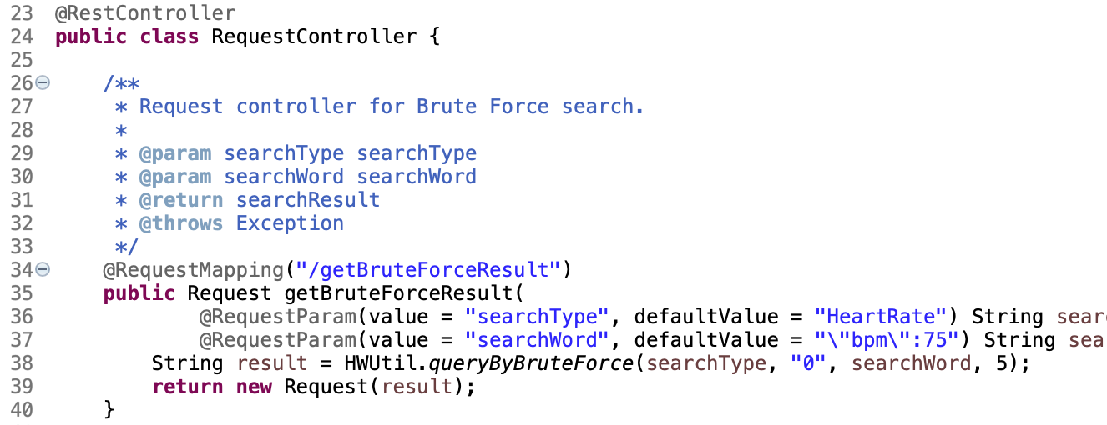
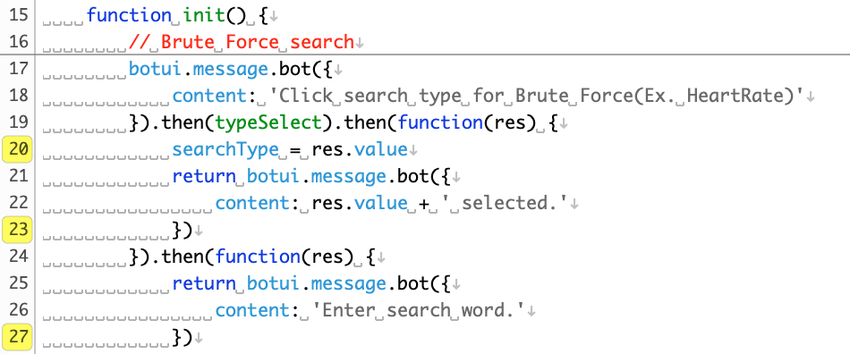
You can build web service almost only with controller and view
Feature: Spring MVC
Folder Structure
Controller
BotUI Javascript

Slide 7
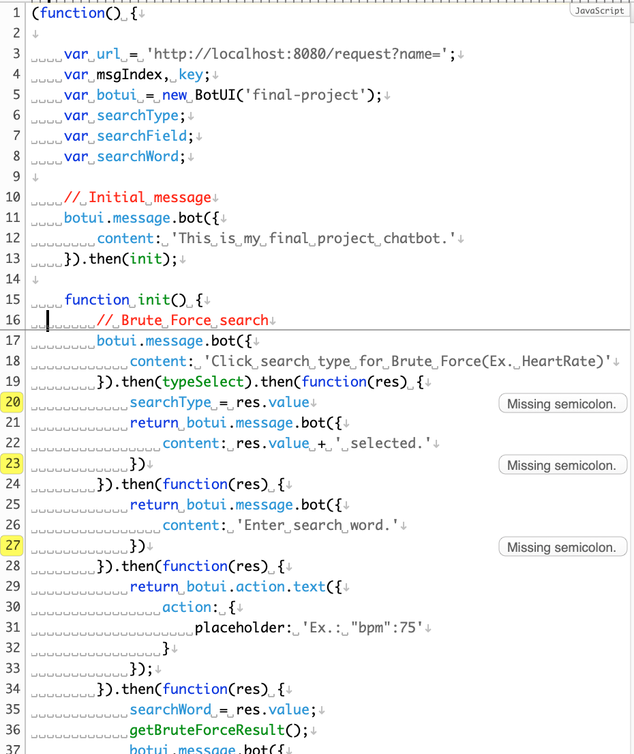
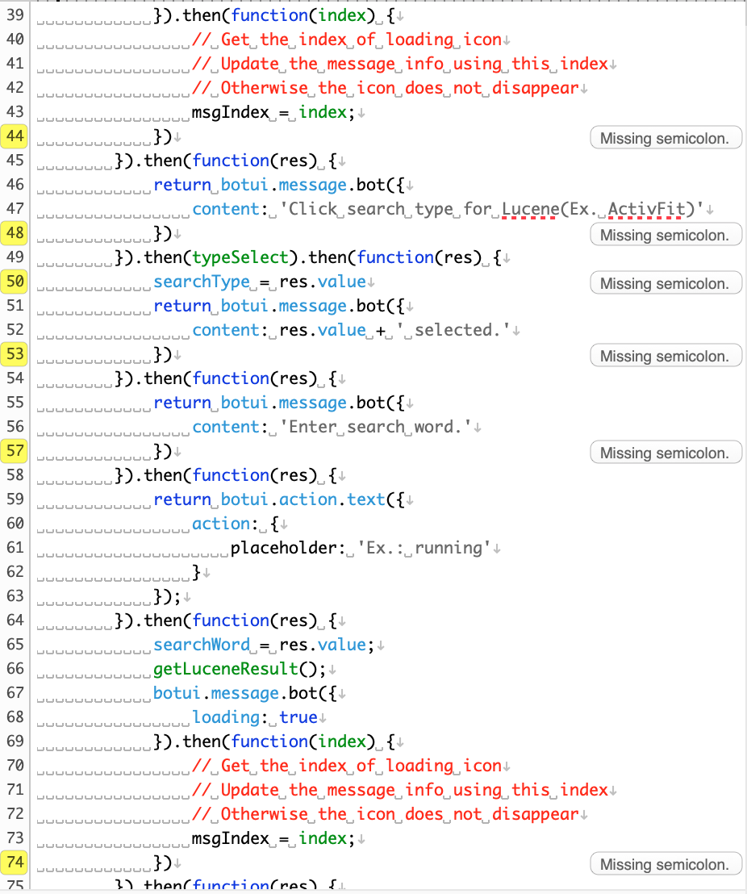
Handling conversation is heavily implemented on the client side
Feature: BotUI
BotUI implementation

Slide 8
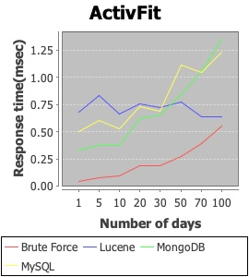
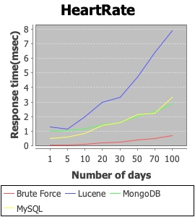
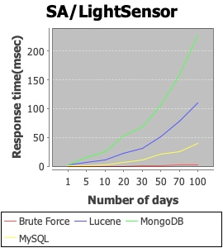
Use StringUtils.contains(), using String.indexOf() inside, for simple search
Performance Test
Short column
Medium column
Long column
"activity":"running”
(935 records in 100days)
"timestamp":"Wed Apr 5 13:00:07 EDT 2017”
(2,137 records in 100days)
”data":”light,6.3333335,Wed Dec 21 00:10:34 EST 2016,less bright,0:00”
(14,214 records in 100 days)

